Slide 1
Oplæg teammøde
Teamsamarbejde og

Slide 2
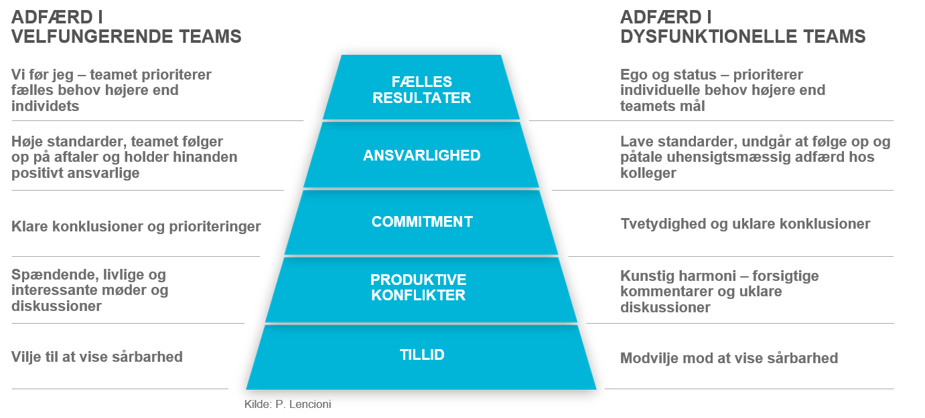
Teamrelationer

Slide 3
Hvad karakteriserer et ‘high performing team’?
De opstiller klare mål, der afspejler teamets og organisationens prioriteter
- High-performing teams har fælles fokus, formål og prioriteter. De opstiller klart definerede teammål og individuelle mål, der understøtter den fælles vision, så alle ved hvad de skal gøre og hvordan de når det fælles mål.
De forstår hvordan arbejdet passer ind i den fælles organisatoriske mission
-> De har klart definerede roller og ansvar
- Konflikt kan hurtigt afspore et ellers talentfuldt og produktivt team. High-performing teams minimerer unødig konflikt ved at definer hver persons rolle og ansvar klart. På denne made undgår man forvirring ift. produktejerskab, man har ordnede processer og deadlines, og man sikrer ansvarlighed hele vejen rundt.
De kommunikerer klart og med respekt
De håndterer arbejdet og deadlines ift. prioriteterne
De udviser respekt og har tillid til hinanden
De fejrer fælles succeser og anerkender hinandens bidrag
- De anerkender at succes skyldes teamets fælles indsats og opbygger en stærk samarbejdskultur
De praktiserer kontinuerlig læring

Slide 4
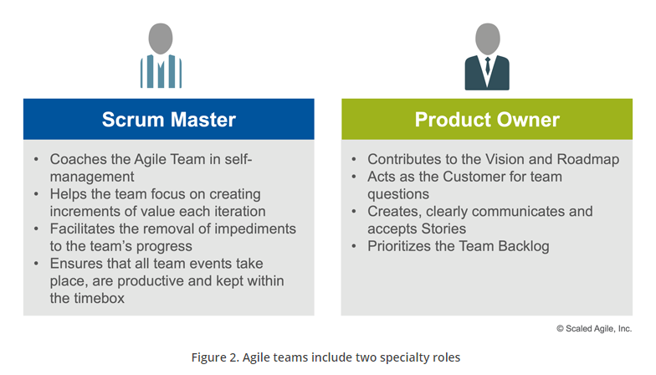
De to specialiserede teamroller

Slide 5
SAFe team roller – teammedlem
Collaborate with the Product Owner to create and refine user stories and acceptance criteria
Participate in PI Planning and create Iteration plans and Team PI Objectives
Develop and commit to Team PI Objectives and iteration goals
Estimate the size and complexity of their work
Use pairing and other practices for frequent review
Determine the technical design in their area of concern, within the architectural guidelines
Conduct research, design, prototype, and other exploration activities
Implement and integrate changes in small batches Create and test the work products defined by their features
Test the work products defined by their features
Deploy the work products to staging and production
Support operational business solutions
Support and/or create the automation necessary to build the continuous delivery pipeline
Continuously improve the team’s process

Slide 6
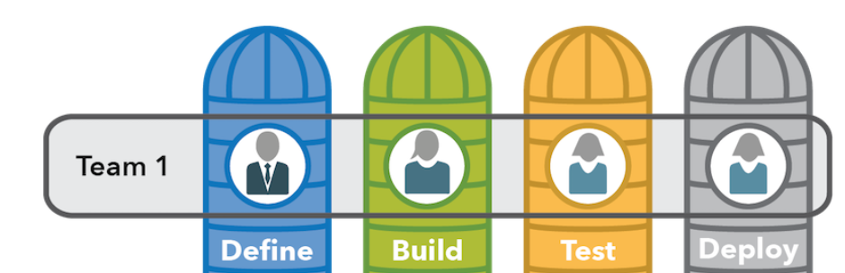
Roller og ansvar
Hvilke kompetencer skal vi have i teamet for at skabe værdi for forretningen?
Definere:
Bygge:
Teste:
Vedligehold (DevOps):
Deployment:

Slide 7
SAFe team roller – PO (proxy for interessenterne)
The Product Owner (PO) is a member of the Agile Team responsible for defining Stories and prioritizing the Team Backlog to streamline the execution of program priorities while maintaining the conceptual and technical integrity of the Features or components for the team.
The PO has a significant role in maximizing the value produced by the team and ensuring Stories meet the user’s needs and comply with the Definition of Done. For most enterprises moving to Agile, this is a new and critical role, typically translating into a full-time job, requiring one PO to support each Agile team (or, at most, two teams).
This role has significant relationships and responsibilities outside the local team, including working with Product Management, Customers, Business Owners, and other stakeholders.

Slide 8
SAFe teamroller – PO (proxy for interessenterne)
PO opgaver
Maintaining the team backlog
- With input from System Architect/Engineering and other stakeholders, the PO has the primary responsibility for building, editing, and maintaining the team backlog (backlog ejerskab og ekstern koordinering)
Iteration Planning
- The PO reviews and reprioritizes the backlog as part of the prep work for Iteration Planning (torsdagsmøde inden sprintplanning)
Just-in-time story elaboration
- any team member can write stories and acceptance criteria, the PO maintains proper flow
Apply Behavior-Driven Development (BDD)
- POs collaborate with their team to detail stories with acceptance criteria and examples in the form of acceptance tests.
Accepting stories
- The PO works with the team to agree on accepted story completion.
Understand enabler work
- While POs are not expected to drive technological decisions, they are supposed to understand the scope of the upcoming enabler work and collaborate with System and Solution Architect/Engineering to assist with decision-making
Participate in team demo and retrospective

Slide 9
SAFe team roller – scrum master (team coach)
Scrum Masters are servant leaders and coaches for an Agile Team. They help educate the team in Scrum, Extreme Programming (XP), Kanban, and SAFe, ensuring that the agreed Agile process is being followed. They also help remove impediments and foster an environment for high-performing team dynamics, continuous flow, and relentless improvement.
The Scrum Master role is taken by a team member whose primary responsibility is assisting the self-organizing, self-managing team to achieve its goals. Scrum Masters do this by teaching and coaching team practices, implementing and supporting SAFe principles and practices, identifying and eliminating impediments, and facilitating flow. They also work with the extended Scrum Master community, including Release Train Engineers and Solution Train Engineers, to increase the effectiveness of SAFe across the enterprise. Details

Slide 10
SAFe teamroller – scrum master opgaver (team coach)
Exhibits Lean-Agile leadership
Supports the team rules
Facilitates the team’s progress toward team goals
Leads team efforts in relentless improvement
Facilitates team events
Supports the Product Owner
Facilitates the removal of impediments
Promotes SAFe quality practices
Builds a high-performing team – Focuses on ever-improving team dynamics and performance, and coaches the team in self-management. Helps the team resolve interpersonal conflicts and challenges, and identify opportunities for growth. Escalates people problems to management where necessary, but only after internal team processes have failed to resolve the issue; helps individuals.
Responsibilities on the train
Coordinates with other teams
Supports SAFe adoption
Enables organizational effectiveness
Supports estimating

